Slide 1
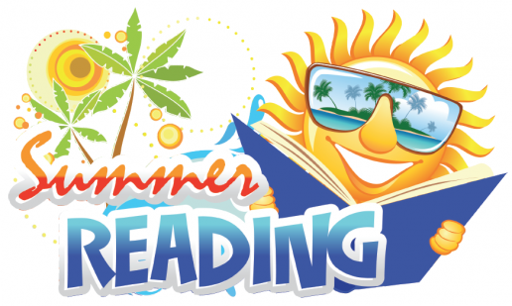
Boosting Literacy over the Summer
Created by: Groveland’s Reading Specialists, Jennifer Butler, Kelly Szemanek, & Rachel Palilonis

Slide 2
In this Powerpoint, you will find…
Importance of Summer Reading
Strategies for Primary
Strategies for Intermediate
Parent Resources
Contact Information

Slide 3
Importance of Summer Reading

Slide 4
How do you make summer reading fun ?
Make reading relevant
Think about topics your child loves
Have conversations about the book
Share extension experiences (activities and trips)- this will deepen learning
Example: Read about fish and then visit a creek

Slide 5
How do you fit it in?
Build into your family life opportunities to read and share books
Quiet time
Morning time
Pool time
Chill Time
Vacation Time
Bedtime
Plan trips to the library
Great resources for books, movies, summer reading clubs
Quiet, cool respite or outside reading areas surrounded by sculptures
https://buckslib.org/
Have active conversations together about days' events, interests, vacations, wishes & dreams

Slide 6
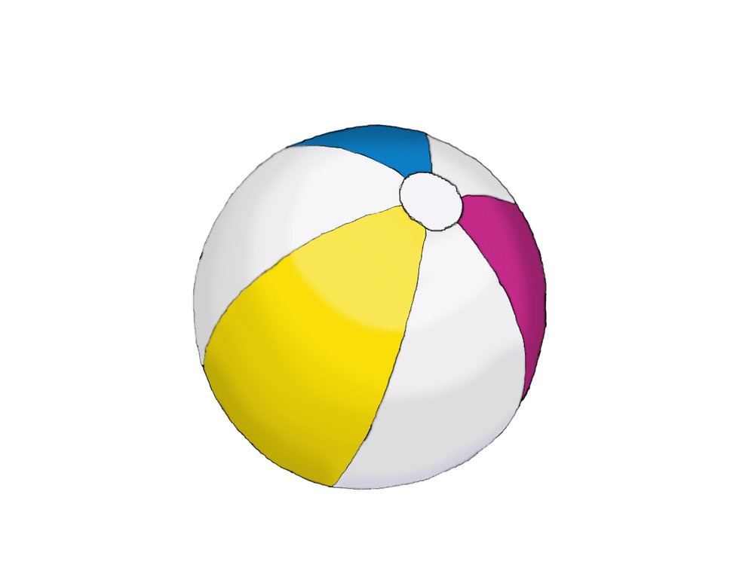
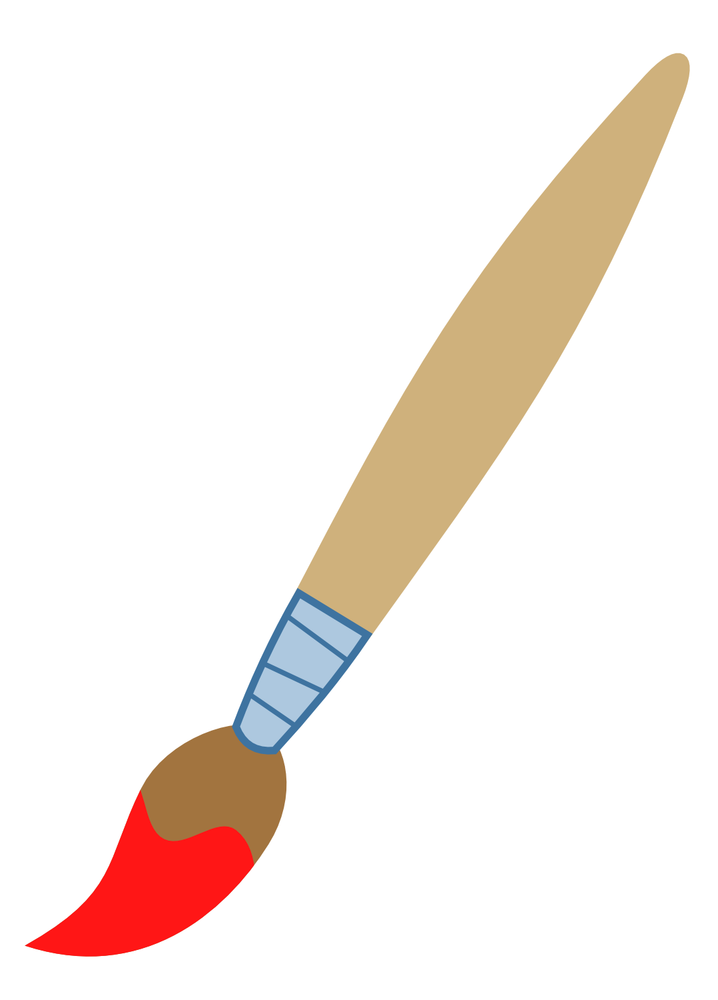
Primary Resources
1. Sticker Stories (This is found in your packet)
What You’ll Need: Stickers, Paper, Markers/Pencils
What To Do: Child creates a picture with stickers. Then ask child to tell you about their picture. Last, child writes the story on paper.
2. Beach Ball Toss
What You’ll Need: Beach Ball, Sharpie marker
What To Do: Parent/Guardian writes sight words on different colors of the beach ball. Toss the ball to each other and wherever child's hand lands is the word he/she reads.
3. Water Sight Word Painting
What You’ll Need: Water, Paint brush, Sight Word List
What To Do: Parent/Guardian calls out sight words. Child uses paint brush and water to "paint" sight word on the driveway or sidewalk.

Slide 7
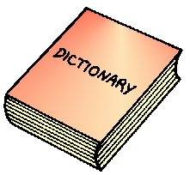
Intermediate Activities
1. Building a Story
What You’ll Need: A brief story or fable
What To Do: Choose a short story, fable, or fairy tale for your child to read. Discuss the story elements (main character, setting, problem, and resolution).
2. Word Wizard
What You’ll Need: A newspaper, magazine, or book. A notebook.
What To Do: Have your child find a word in a newspaper, magazine, or book that he or she does not know and has not seen before. Continue to look for that word in other sources and use it in conversation.
3. My Turn, Your Turn—Our Story
What You’ll Need: Paper, pencil, and a story title.
What To Do: Create or choose an exciting title for a story. Continue taking turns with the pencil writing the story.

Slide 8
Parent Resources- Book Selection Websites
www.startwithabook.org (Start with a Book)
Themed books and activities for summer reading and learning that builds background knowledge and deepens summer learning.
www.readingrockets.org/books/booksbytheme (Reading Rockets)
Search through more than 5,000 books on Reading Rockets to create a custom booklist. Search by author, illustrator, age, reading level, genre, format, and topic. Tap into what interests your child!
https://www.whatshouldireadnext.com/index.php (What Should I Read Next?)
Search a book based on the last book that you have enjoyed, and this website will find books that are similar.
https://www.cbsd.org/Page/44656 (Barnes and Noble)
Inside your packet, you will see a Barnes and Noble Reading Challenge paper.
If your child reads eight books, records their favorite part on a log, it can be redeemed for a free book from a selected list.

Slide 9
Parent Resources – Videos & Apps
You can find this video at: https://www.youtube.com/watch?v=e_2NLGaaGu8
You will also find in your packet:
Groveland's App List
Kahn Academy App (K-2)

Slide 10
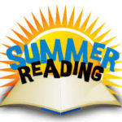
Happy Summer Reading!
From the Groveland Reading Department:
Kelly Szemanek- kszemane@cbsd.org
Jennifer Butler-jbutler@cbsd.org
Rachel Palilonis- rpalilonis@cbsd.org

